Slide 1
Cryptographic Technologies
Chapter 5

Slide 2
Goals of Cryptography
Four primary goals
Many applications provide multiple cryptographic benefits simultaneously
Confidentiality is most commonly addressed goal
  The meaning of a message is concealed by encoding it
  The sender encrypts the message using a cryptographic key
  The recipient decrypts the message using a cryptographic key that may or may not be the same as the one used by the sender

Slide 3
Goals of Cryptography (continued)
Integrity
  Ensures that the message received is the same as the message that was sent
  Uses hashing to create a unique message digest from the message that is sent along with the message
  Recipient uses the same technique to create a second digest from the message to compare to the original one
  This technique only protects against unintentional alteration of the message
  A variation is used to create digital signatures to protect against malicious alteration

Slide 4
Goals of Cryptography (continued)
Nonrepudiation
  The sender of a message cannot later claim he/she did not send it
  Available with asymmetric cryptosystems that can create digital signatures
Authentication
  A user or system can prove their identity to another who does not have personal knowledge of their identity
  Accomplished using digital certificates
  Kerberos is a common cryptographic authentication system

Slide 5
Cryptographic Algorithms
Two types of cryptographic algorithms
  Symmetric and asymmetric
A cryptographic algorithm is used to encrypt a message
  Change from plaintext to ciphertext
And then decrypt the message
  Change from ciphertext back to plaintext
Early algorithms embodied “security through obscurity”
Current algorithms are rigorously and openly examined

Slide 6
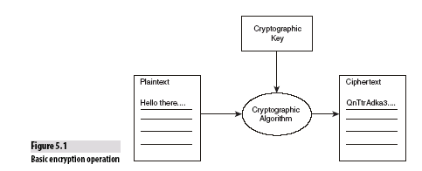
Cryptographic Algorithms (continued)

Slide 7
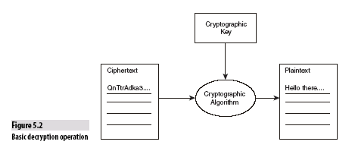
Cryptographic Algorithms (continued)

Slide 8
Symmetric Algorithms
Symmetry results from the sender and receiver using the same key
Key is called shared secret key or secret key
Symmetric cryptosystems sometimes called secret key cryptosystems
Key length is a critical component of security

Slide 9
Key Length
The longer the key, the greater the degree of protection
A common attack against cryptosystems is the brute force attack
  All possible keys are tried
  Longer keys create an enormous number of possible combinations, frustrating brute force attacks
  Formula used to compute the number of combinations is 2^{n} where n is the key length in bits

Slide 10
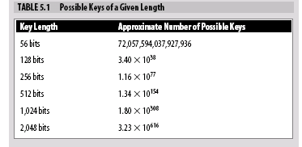
Key Length

Slide 11
Data Encryption Standard (DES)
One of the most common symmetric cryptosystems
Uses a 56-bit key with four modes of operation
  Electronic codebook, ciphertext block chaining, output feedback, ciphertext feedback
The DES algorithms are very flexible
A fatal flaw
  A 56-bit key is no longer considered strong enough to survive brute force attacks
Current versions of DES use three separate iterations of DES encryption on each message
  Triple DES (3DES)

Slide 12
Data Encryption Standard (continued)
3DES provides an acceptably strong level of protection
Variations of 3DES use either 2 or 3 keys
  3DES-EEE (encrypt-encrypt-encrypt) uses 3 keys
  3DES-EDE (encrypt-decrypt-encrypt) can use from 1 to 3 keys with different levels of protection

Slide 13
Advanced Encryption Standard (AES)
Solicited in a competition sponsored by the National Institute of Standards (NIST)
Candidate algorithms published their inner workings
Winner was the Rijndael algorithm
AES allows the user to select from 3 different key lengths
  128, 192, or 256 bits
  The longer the key, the greater the security
AES is gaining momentum, but the volume of applications that use DES makes conversion slow

Slide 14
Asymmetric Algorithms
Differ from symmetric algorithms because sender and receiver use different keys
Each user has a pair of keys
  Public key and private key
  Keys are mathematically related
  Messages encrypted with public key can only be decrypted with private key
  Public keys are freely distributed so that anyone can use them to encrypt a message
Asymmetric algorithms are referred to as public key cryptosystems

Slide 15
Asymmetric Algorithms Example
Renee and Michael wish to communicate sensitive information
  Renee and Michael share their public keys
  When Renee sends a message to Michael, she encrypts it with Michael’s public key
  Only Michael can decrypt the message because decryption requires his private key, which he does not share with anyone

Slide 16
Asymmetric Algorithms (continued)
Rivest, Shamir, Adelman algorithm (RSA)
  One of the most well-known public key cryptosystems
  Developed in the late 1970’s
  Relies on the fact that it is extremely difficult to factor large prime numbers
Pretty Good Privacy (PGP)
  A cross-platform solution
  An implementation of several cryptographic algorithms (including RSA)
  Supports management of a decentralized public key infrastructure

Slide 17
The Web of Trust
Key exchange is a difficult problem
  Before PGP, it was necessary to exchange keys offline
PGP introduced the “web of trust” model
  Allows users to rely on the judgment of others that a public key is authentic
Four levels of trust
  Implicit trust
  Full trust
  Marginal trust
  Untrusted

Slide 18
Symmetric Versus Asymmetric Cryptosystems
Choice between symmetric and asymmetric cryptosystems involves the number of keys that must be generated
  Symmetric cryptosystems don’t scale well
  Asymmetric cryptosystems are slower than symmetric ones
  Symmetric cryptosystems are excellent for securing the ends of a communication circuit such as a Virtual Private Network
  Asymmetric cryptosystems are more practical when there are a large number of users

Slide 19
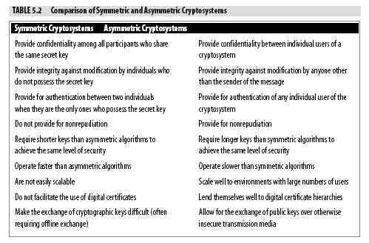

Slide 20
Digital Signatures
Add integrity and nonrepudiation functionality to cryptosystems
Nonrepudiation can only be enforced with asymmetric algorithms
Signature creation
  A unique message digest is created by applying a hash function to the message
  Variations of the Secure Hash (SHA) and MD Algorithms are commonly used
  Sender encrypts the message digest with his/her private key

Slide 21
Digital Signatures (continued)
Signature verification
  Recipient decrypts the message and extracts the plaintext message and digital signature
  Recipient applies same hash function to the message as that used by the sender to create a new message digest
  Recipient decrypts the digital signature using the sender’s public key to extract the sender’s message digest
  The recipient compares the two message digests
  If the message digests match, signature is authentic
  Non-matching signatures can be malicious but also can be due to transmission errors, etc.

Slide 22
Digital Certificates
Digital certificates allow a third party to vouch for a digital signature
The third party does the work to verify the identity of the sender
Certification Authorities
  The third parties that verify and certify the identity of a sender
  Two of the most common CAs are VeriSign and Thawte

Slide 23
Digital Certificates (continued)
Certificate generation
  Sender selects and pays a CA
  Sender submits required information for CA to verify their identity
  CA issues a digital certificate following the X.509 standard
  CA signs the digital certificate
Certificate verification
  A digital certificate can be used to securely transmit the sender’s public key to any entity that trusts the CA and accepts the certificate

Slide 24
Summary
Goals of cryptography are confidentiality, integrity, nonrepudiation, and authentication
General steps in cryptography are to
  Create a plaintext message
  Use a cryptographic key and algorithm to produce a ciphertext message
  Apply the same or a related key and algorithm to the ciphertext message
  Recreate the original plaintext message
There are two types of cryptographic algorithms
  Symmetric (uses a shared secret key)
  Asymmetric (uses a public and private key pair)

Slide 25
Summary
Digital signatures are used to add integrity and nonrepudiation functionality to cryptosystems
Digital signatures are created using hash functions applied to the message to create a message digest that is then encrypted
Digital certificates allow a third party Certificate Authority to verify the identity of a sender who may not be well known to the recipient
A digital certificate is a copy of a user’s public key that has been digitally signed by a Certificate Authority.

